Slide 1
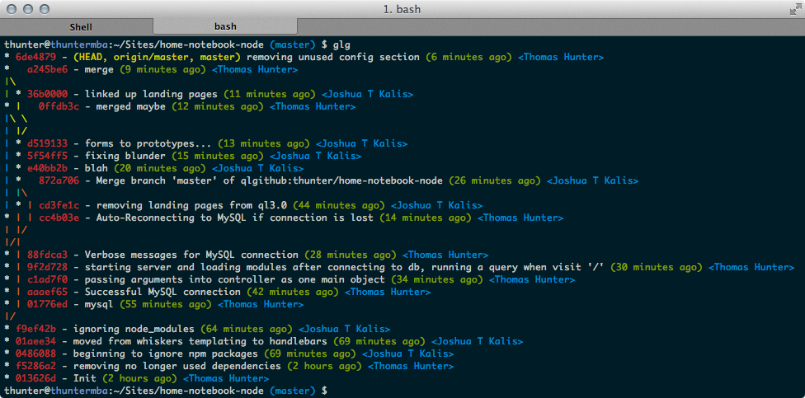
ATMS 305 Week 1: Introduction to unix/linux
Lecture 1: linux/unix basics

Slide 2
Linux is the workhorse that brings you the internet and computation
Invented in the 1960’s, UNIX, and then LINUX, is the operating system that powers the majority of servers today. It is an operating system that allows for executing computer code, storing files, and accessing the internet. It also has an optional graphical user interface (GUI).
Why?
Mostly free and “open source”
Works on almost all PCs
Mac OS is a flavor of linux
Windows 10 (post 2016 Anniversary Update) has a linux kernel
Huge user community that is generally helpful
Most computing software/internet servers are easiest to use on linux

Slide 3
Linux has many “flavors”
Types of “kernels” – a.k.a. the “brand of linux”
Types of “shells” (available on any kernel) – terminal syntax for issuing commands
Fedora
Ubuntu
Linux Mint
CentOS → what we will be using
Debian/OS X
OpenSUSE
csh
tcsh
sh
bash → what we will be using
ksh

Slide 4
ACCESSing the LINUX/BASH terminal
Local machine:
PC: Bash for Windows 10 (need Anniversary Edition, still in beta), otherwise there are some bash interpreters for Windows (not recommended)
OS X: Terminal.app
linux desktop: Terminal is available, accessed through the menus

Slide 5
ACCESSING the linux terminal in this course
We will use the Atmospheric Sciences cluster keeling.earth.illinois.edu in this course.
This host is behind the campus firewall, so if you are off campus, you need to use the CITES VPN software available from the Software Webstore to enable access. The hostname vpn.cites.illinois.edu. Use the ‘Split Tunnel” profile.
Connect using the secure shell or ssh, log in with your NetID and password:
PC: Use one of the terminal emulators on the previous slide.
OS X/linux: From a terminal window, type
ssh netID@keeling.earth.illinois.edu

Slide 6
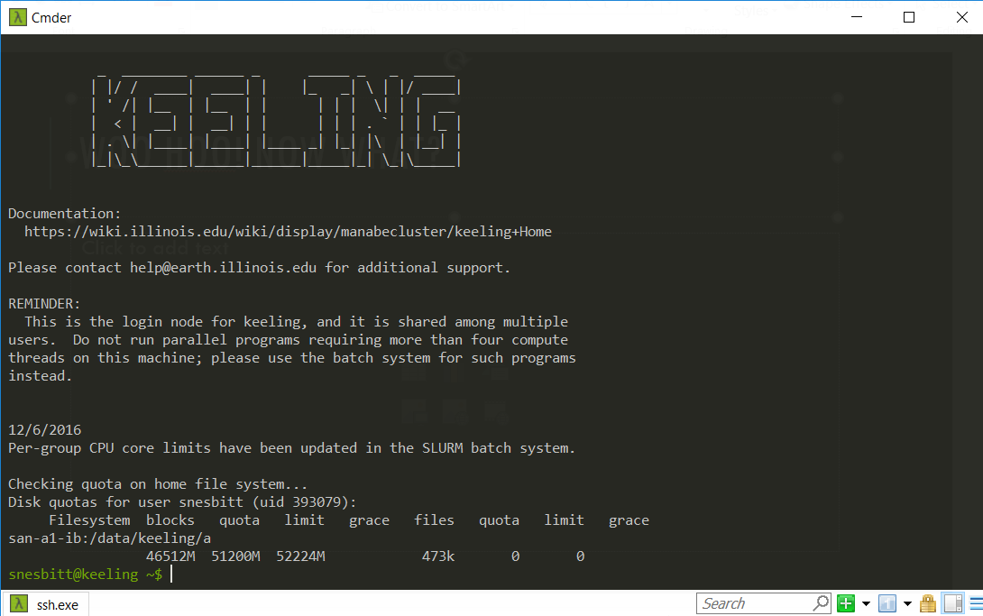
Woo hoo! Now what?

Slide 7
Now you’re ready to roll, but one sec
A few one time setup items:
Change your shell to bash
Type chsh
Enter netID password
Enter /bin/bash when prompted.
Now you’re running with the bash shell.

Slide 8
A word about keeling
Keeling is named after Charles Keeling, the UIUC grad that discovered that CO₂ was rising due to anthropogenic sources, established Mauna Loa Observatory in Hawaii
Keeling (the computer) is a linux cluster operated by the Department of Atmospheric Sciences supported by SESE Computer Services.
We have been given computing accounts for class purposes only on this machine. Please respect our privileges on this machine and do not abuse the resources.
We have a class data directory in the folder /data/atms305/a/netID which has about 5 GB of space per user.
We also have the ability to use the batch queueing system to run jobs on the cluster. Interactive jobs are run with the command qlogin. Try to run qlogin when possible.

Slide 9
Bash on linux: now what?
Linux allows you to run commands, write scripts that can perform tasks automatically or repetitively, interact with the file system, and access the internet, among other things you would expect a computer to do. Using the terminal, we can run commands that are at a very low level in the operating system.
However, the terminal requires knowledge of basic linux commands.
Also, to generate and edit scripts and files, you need to be able use a text editor.
To use the internet from the terminal, you need other commands.
Let’s go through some useful commands!

Slide 10
Editing files
There are several text editors available on linux, including pico, vi, and emacs.
pico is probably the easiest, but least powerful.
It has a keyboard menu system that helps guide you through the process of saving, opening, finding and replacing text, etc.
Example: pico test.txt
This will open test.txt for editing (if you have permissions, we will talk about that later) ☺

Slide 11
Top 15 linux commands
# 1: cd
The "Change Directory" command enables you to navigate to another directory.
The cd command is THE most important command there is in linux i think. As the command suggests, it enables the user to change / jump to a directory.
Example: cd Downloads Example: cd /etc/ Example: cd .. (Directory up!) note: Afher you have typed cd and entering the first or two letters of the directory you can press the TAB key to autocomplete the directory! so... cd Do (press tabkey) will autocomplete it to Downloads.

Slide 12
Top 15 linux commands
#2: man
The man command shows the users the "manual" of the command. In some situation you might need to get more information about the command you are using. The man command shows you this information about the command.
Example: man cp
This will open up the "cp" manual document for us in the shell. The manual shows us the parameters available for the commands.
note: To close the manual simply press "Q".

Slide 13
Top 15 linux commands
#3: ls
In the absolute top 15 there's no way the ls command is missing. On the third place, the ls command. The ls command is used to list the files/directories within a directory.
Example: ls
It shows us the directories and files available.
Another example: ls -a
This shows the directories and “details” about the files.

Slide 14
Top 15 linux commands
#4: cp
The cp command is available for us to "Copy" things. This might be usefull for duplicating files f.e.
Example: cp file file2
note: file is on this case the file the user wants to be copied... file2 is the name of the copied file. It's that simple.
Another example: cp –R /data/directory/test /data/directory/test2
This will copy the directory test into the directory test2

Slide 15
Top 15 linux commands
#5 mv
The mv command is used for "Move" operations. The mv commands enables the users to move a file/directory to a specified location.
Example: mv /home/bas/Desktop/bla /home/bas/Desktop/blahblah
note: the first part of the command is the file that has to be moved. The second part (after the whitespace) is the target directory. Make sure you type in the path you intend to using this command!
Another example: mv –fi /data/keeling/a/snesbitt/testdirectory /data/keeling/a/ahuang11
This will move the directory and everything in it called testdirectory to the specified path.

Slide 16
Top 15 linux commands
#6 mkdir
This command is used to "make" directories, NOT Files.. (this is possible with another command which I will bring up later in this tutorial)
Example: mkdir testdirectory
note: The name of the directory is case sensitive which means that Testdirectory is a complete different directory as testdirectory.

Slide 17
Top 15 linux commands
#7 rmdir
When you are able to make directories, you also want to know how to remove them. Removing directories is done by the rmdir command and belongs to the absolute basic commands in shell bashing.
Example: rmdir testdirectory
note: When the directory is not empty the command will prompt an error message:
rmdir: failed to remove `testdirectory': Directory not empty
So make sure it's completely empty before removing it.

Slide 18
Top 15 linux commands
#8 touch
Now we know how to make directories and deleting them, i now want to use the touch command. The touch command is used to make files.
Example: touch vogel
This will create the file vogel for us in the directory.

Slide 19
Top 15 linux commands
#9 rm
The rm command stand for remove. The rm command is used in order the delete files instead of directories.
Example: rm vogel
note: To remove files you must have the right permission bits set on the specific file.
Another example: rm -rf Downloads
Remove everything forcibly and recursively, i.e., everything below and including that file.
Be careful with this command, it can ruin your day if not used with care!
rm -rf /Users/snesbitt ☹

Slide 20
Top 15 linux commands
#10 cat
The cat command gives a listing of a file.
Example: cat test.txt
This will print the file to the terminal.
See also more, less, head, and tail.

Slide 21
Top 15 linux commands
#11 grep
The command grep searches for matching strings in files.
Example: grep test file.txt
This will list the matching lines in the files.

Slide 22
Top 15 linux commands
#12 history
The history command will list the commands you have entered, so you can find what you have done already.
Example: history
A number is displayed next to the command. You can either use the up arrow to go back to the previous command, or type an exclamation point followed by the job number in the history.
Example: !45

Slide 23
Top 15 linux commands
#13 top
The top command tells you what the most intensive processes are currently running on the system.
Example: top
A table of the top cpu using commands is listed, as well as other relevant information, including the process identification number (or PID).
kill [PID] will kill an executing program (which you have permission to halt).

Slide 24
Top 15 linux commands
#14 pwd
What is my current directory? pwd will tell you!
Example: pwd
It just tells you the path in the file system at the current location.
Useful if you are lost!

Slide 25
Top 15 linux commands
#15 chmod
In linux, files have 3 levels of users (yourself, a group, and everyone), and 3 levels of access (read, write, and execute).
You can set the permissions of the files you own using the chmod command. The simplest approach is to assign numbers to each capability (4 for read, 2 for write, 1 for execute) and then to use addition when combining numbers. Thus, 6 = 4+2 (read plus write permission), and 7 = 4+2+1 (all three permissions added together).
Within this framework, you set permissions for a file by specifying the desired capabilities for the user, group, and world (in that order). Thus, when she set up her directory for CSC 105 above, Ms. Coahran might have issued the command
chmod 755 csc105
Here, the user (Ms. Coahran) has full permissions (7=read+write+execute); while the others can read and execute, but not write (5).
Use ls -a to inspect permissions.

